Slide 1
Exploratory Testing
Session 17

Slide 2

What can you tell me about exploratory testing?
Could someone write a book on it?

Slide 3
3 kinds of testing:
Planned (scripted)
Exploratory
Ad-hoc

Slide 4
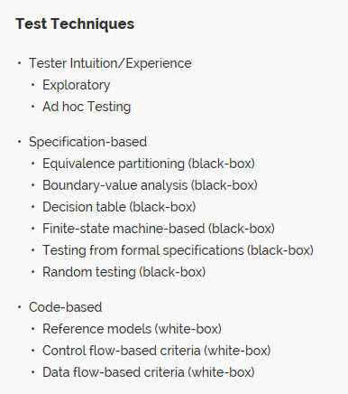
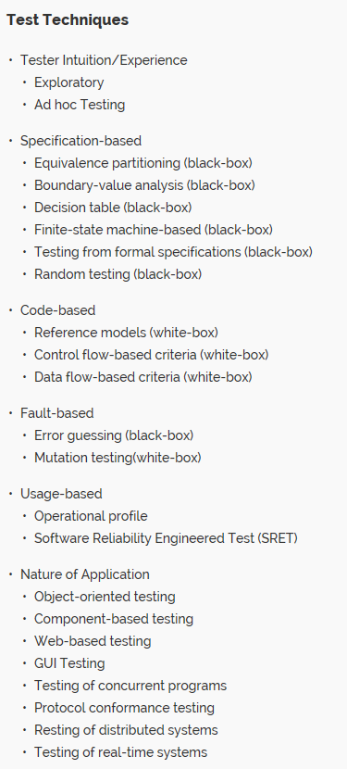
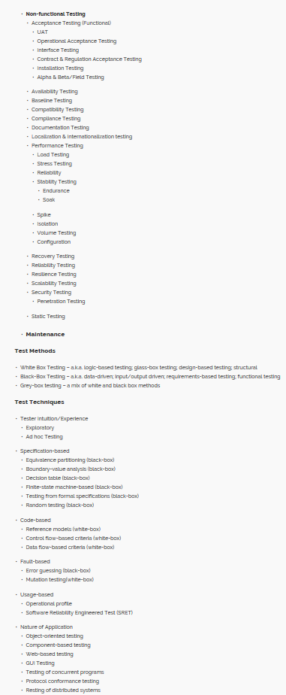
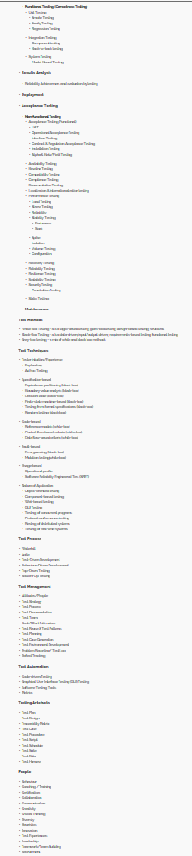
Scratching the Surface
http://testhuddle.com/forums/topic/taxonomy-of-software-testing-terms/

Slide 5

3 kinds of testing:
Planned (scripted)
Exploratory
Ad-hoc
more value to the testing community
“coexist quite nicely”
both rely on the talent & experience of the tester
limited usefulness
Can you smell a bug?

Slide 6
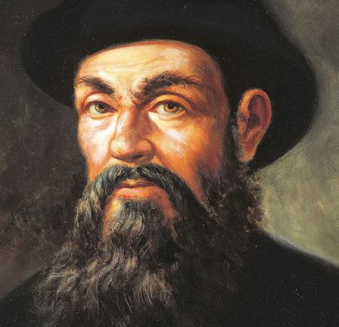
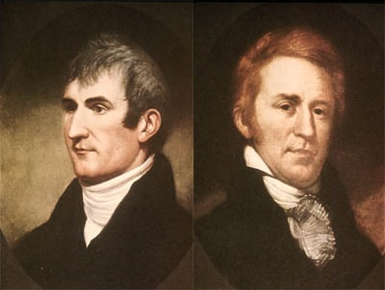
Who Am I?
F. Magellan
The book uses a different analogy…
The key points of the analogy are:
Explorers are not aimless wanderers -- they have specific goals and missions
Explorers are adaptive learners
Expeditions are staffed with resources and teams
They carefully document the findings of their expeditions

Slide 7
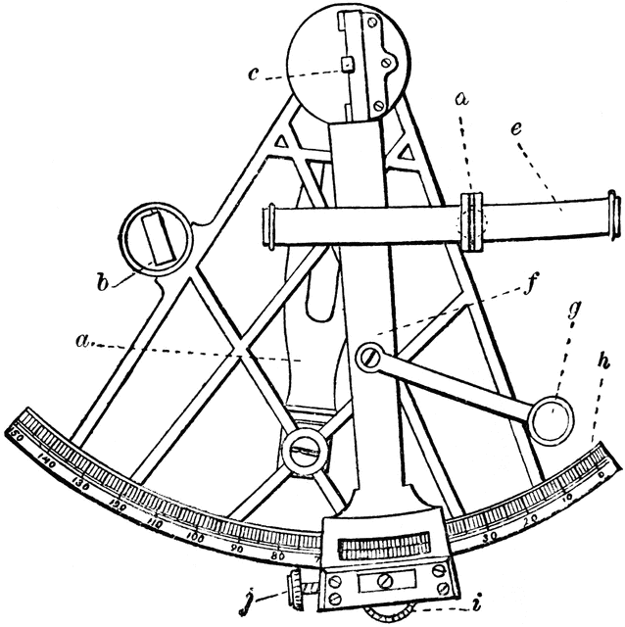
Factors that affect exploratory testing
what the tester knows about the product
- what just happened in the previous test
- known problems with it
- past problems with it
- strengths and weaknesses
- risk areas and magnitude of perceived risk
- recent changes to it
- direct observations of it
- rumors about it
- the nature of its users and user behavior
- how it’s supposed to work
- how it’s put together
- how it’s similar to or different from other products
Imagine this with your project.
Imagine this in a large-scare s/w engineering effort.

Slide 8
Footnote: Historical Origins
2001: Brian Marick participates in the Snowbird event leading to the publication of the Agile Manifesto; he has often described himself as the "token tester" of the group, bringing some awareness of practices within exploratory testing to the Agile community
2008: an emerging definition of exploratory testing is given by Cem Kaner, reflecting the continuing refinement of this approach to testing
Kaner had been extolling the benefits of exploratory testing since the 1990s
Wikipedia quote: the approach tends to be more intellectually stimulating than execution of scripted tests
See more at: http://guide.agilealliance.org/guide/exploratory.html#sthash.dqvAwEQM.dpuf

Slide 9
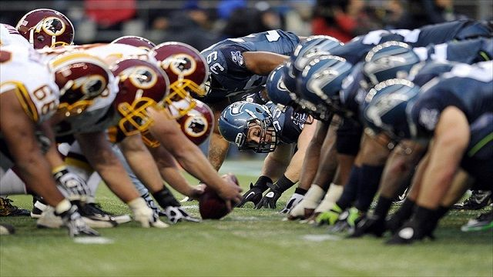
My analogy
Scripted testing is like the game plan
Exploratory testing is like the halftime adjustments

Slide 10
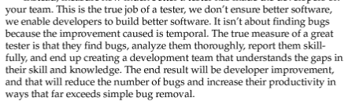
Book excerpt…

Slide 11
This slide intentionally left blank

